Slide 1
Al-BASED TOOL FOR PRELIMINARY DIAGNOSIS OF DERMATOLOGICAL MANIFESTATIONS
CSE7101- Capstone Project
Review-2
Batch Number: CSE_4
Under the Supervision of,
Mr. Jerrin Joe Francis
Assistant Professor
School of Computer Science and Engineering
Presidency University
Roll Number | Student Name
20221CSE0374 | LAKSHMI PRIYA NARAYAN
20221CSE0046 | HEMANTH K
20221CSE0045 | VANKAM VISWA SAI
Name of the Program: BTech-Computer Science and Engineering
Name of the HoD: Dr. Asif Mohammed
Name of the Program Project Coordinator: Dr. Jayavadivel Ravi
Name of the School Project Coordinators: Dr. Sampath A K , Dr. Geetha A

Slide 2
Problem Statement Number: PSCS_49
Organization: Ministry of AYUSH
Category (Hardware / Software / Both) : Software
Problem Description: The Global Burden of Disease project has shown that skin diseases continue to be the 4th leading cause of nonfatal disease burden worldwide. These conditions are often the presenting face of more severe systemic illnesses, including HIV and neglected tropical diseases (NTD). such as elephantiasis and other lymphedema causing diseases. Additionally, skin disorders pose a significant threat to patients' well-being, mental health, ability to function, and social participation. However, it is very difficult to provide better dermatological care to under-served or resource poor regions in a cost-effective manner owing to unavailability of efficient diagnostic tools, lack of connectivity, and poor laboratory infrastructure etc. Moreover, there is also a scarcity of physicians with dermatological training. Even, preliminary screening of a dermatological manifestation seems to be an arduous task. Thus, developing an Artificial intelligence-based tool (through Image processing technique) for preliminary diagnosis of numerous dermatological conditions will prove to be a boon in the health care system.

Slide 3
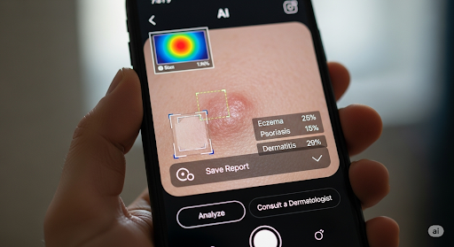
Objective
Develop an AI for preliminary diagnosis of skin diseases.
Achieve high accuracy using deep learning (CNNs).
Ensure accessibility by enabling offline use on standard mobile phones.

Slide 4
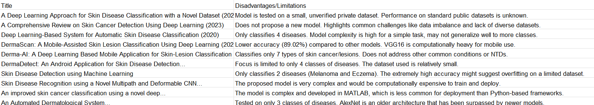
Existing Methods and Drawbacks

Slide 5
Summary and Critique
Summary:
Narrow Scope: Most models only classify a small number of diseases (often just 2-4), focusing almost exclusively on skin cancer.
Weak Data: Many rely on small, private datasets, which hurts the generalizability and reproducibility of their results.
Impractical Design: Several proposed models are too complex or use outdated technology, making them computationally expensive and unsuitable for real-world deployment.
Critique: Collectively, these limitations show that most academic projects in this field are not yet practical for clinical use. There is a clear research gap and an opportunity to build a more comprehensive tool that classifies a wider range of relevant diseases and is engineered for efficient, real-world application.

Slide 6
Proposed Methods and Feasible Study
Proposed Method:
We will develop a web-based diagnostic support software using a custom-trained
Convolutional Neural Network (CNN).
The system will classify 16 skin conditions, including common lesions, inflammatory diseases,
and Neglected Tropical Diseases (NTDs).
A user uploads an image and receives a preliminary diagnosis with confidence scores and a
visual explanation.
Innovation & Justification:
Hyper-Local Focus: Unlike existing tools, our model is uniquely trained on
NTDs and other conditions prevalent in the Indian subcontinent, addressing a
critical healthcare gap.
Explainable AI (XAI): We will implement Grad-CAM to generate heatmaps that highlight the
features the AI used for its diagnosis, building user trust and providing deeper insight.
High Impact: The solution empowers non-specialist healthcare workers, directly addressing a current
and relevant societal need.

Slide 7
Feasibility Study:
Technology: The project uses a standard, open-source stack (Python, TensorFlow, Flask) with model training on accessible cloud platforms like Google Colab.
Cost: There are zero software licensing costs.
Resources: We will leverage large public datasets (e.g., HAM10000) and augment them with targeted image collection for the NTD classes.

Slide 8
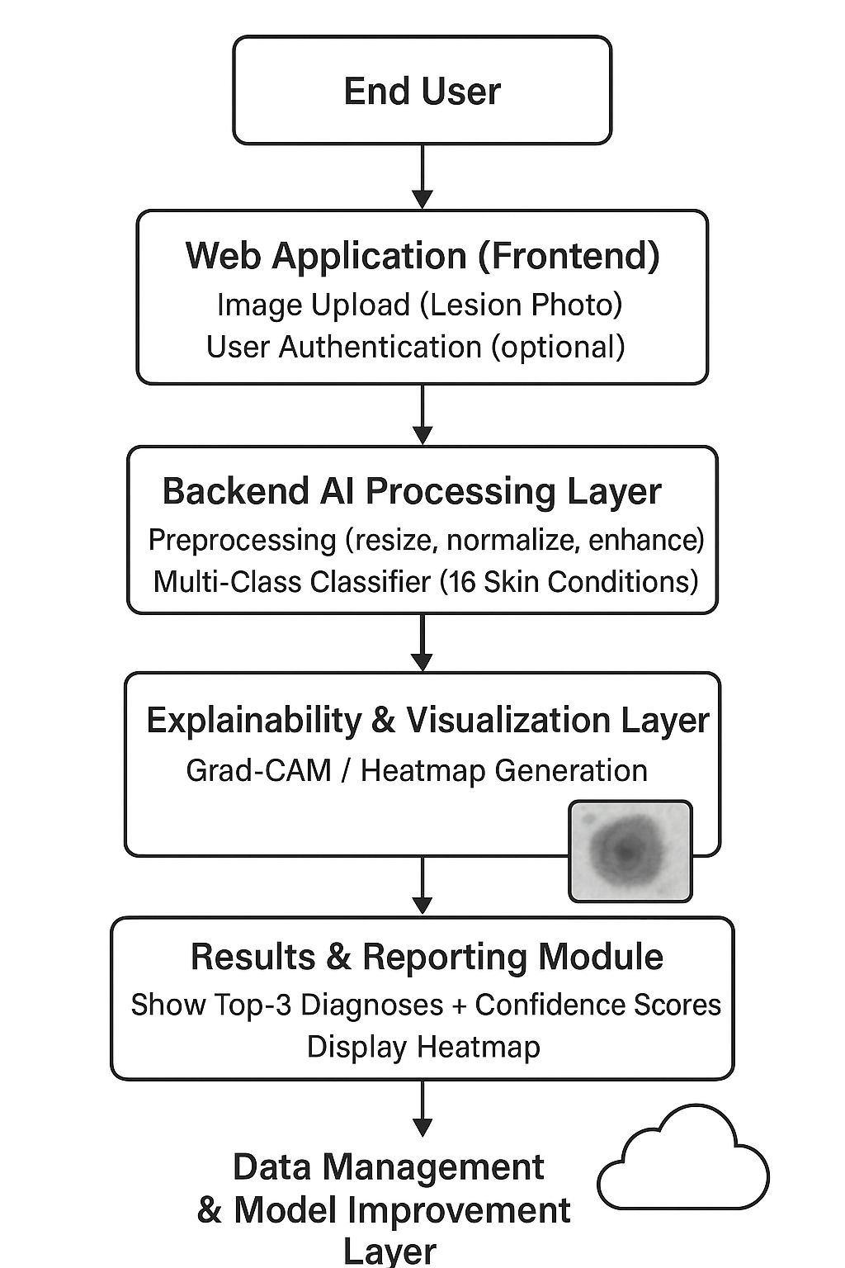
Architecture Diagram

Slide 9
Modules
Our proposed system is designed with a modular architecture to ensure clarity and scalability. The key modules are:
User Interface (UI) & Image Upload Module:
Functionality: Provides a clean, user-friendly web interface for healthcare workers to securely upload an image of a patient's skin lesion.
Image Preprocessing Module:
Functionality: Automatically receives the uploaded image and prepares it for the AI model. This includes resizing to the required input dimensions, normalization of pixel values, and any necessary cropping or enhancement.
AI Inference Engine:
Functionality: This is the core of the system. It takes the preprocessed image and feeds it into our pre-trained, 16-class Convolutional Neural Network (CNN) to generate a prediction vector containing confidence scores for each disease.
Results & Visualization Module:
Functionality: Renders the AI model's output in an easy-to-understand format. It displays the top 3-5 potential diagnoses with their confidence percentages and generates a Grad-CAM heatmap overlay on the original image to visually explain the model's reasoning.

Slide 10
Github Link
Github Link:
lakshmipriyanarayan/CSE_4_PSCS_49

Slide 11
Analysis of Problem Statement (contd...)
Software and Hardware Requirements:
HARDWARE REQUIREMENTS:
Development PC/Laptop
CPU: Intel i5 / AMD Ryzen 5+
RAM: 16 GB
GPU: NVIDIA (6GB+ VRAM)
Storage: 512 GB+ SSD
Android Smartphone
Cloud Alternative: Google Colab (for GPU)
SOFTWARE REQUIREMENTS:
OS: Windows / macOS / Linux
Core Tools:
Visual Studio Code
Git & GitHub
Android Studio
AI Stack (Python):
Python
TensorFlow, Keras
TensorFlow Lite (TFLite)
OpenCV, Pillow
Scikit-learn
Jupyter Notebook
Mobile App Stack (Flutter):
Flutter SDK
Dart SDK

Slide 12
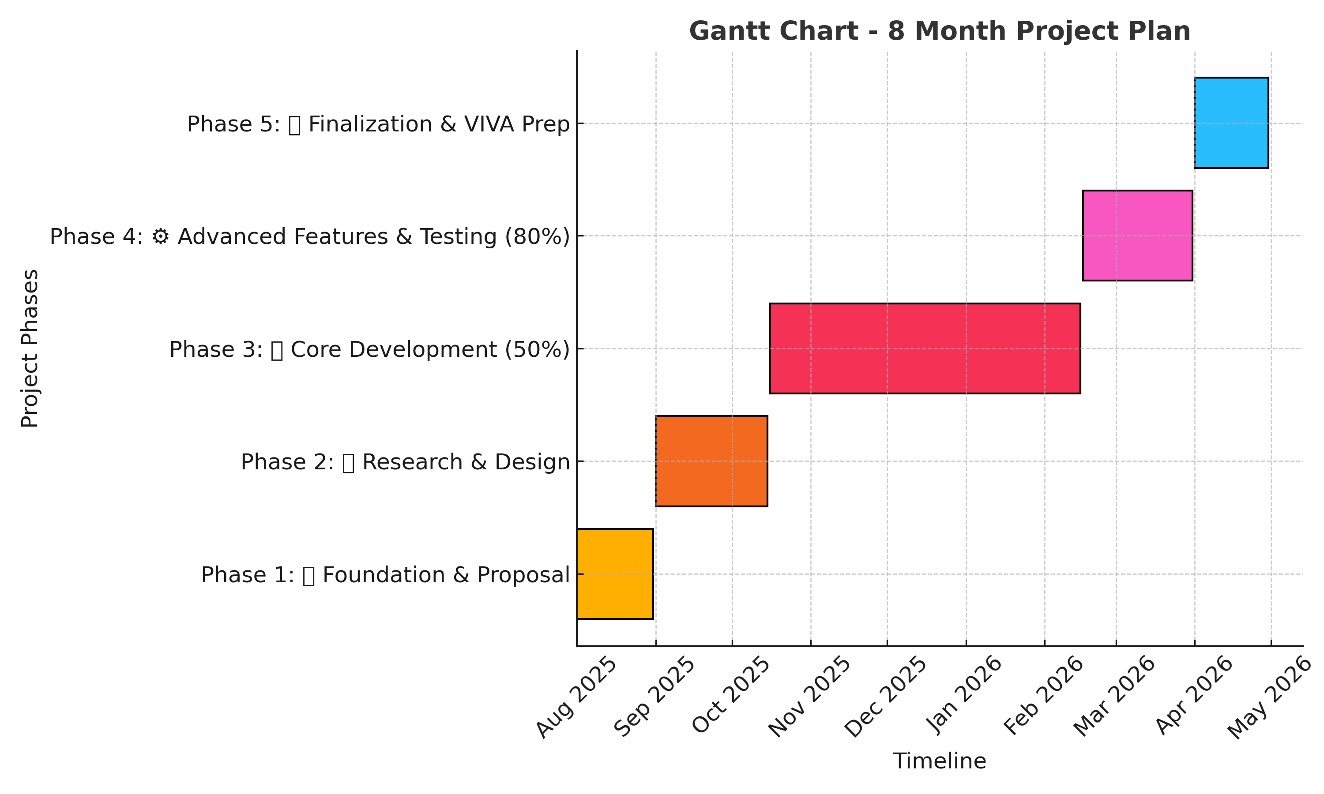
Timeline of the Project (Gantt Chart)

Slide 13
References (IEEE Paper format)
[1] S. S. H. K. S. E. Jayathilake and D. U. J. Sonnadara, "A Deep Learning Approach for Skin Disease Classification with a Novel Dataset," in 2022 IEEE 16th International Conference on Application of Information and Communication Technologies (AICT), 2022, pp. 1-6.
[2] M. I. L. S. T. Z. B. M. Ali, M. A. H. Talukder, and S. A. Hossain, "A Comprehensive Review on Skin Cancer Detection Using Deep Learning," in 2023 IEEE 14th Annual Ubiquitous Computing, Electronics & Mobile Communication Conference (UEMCON), 2023, pp. 0544-0550.
[3] A. Adegun and S. Viriri, "Deep Learning-Based System for Automatic Skin Disease Classification," in 2020 IEEE 15th International Conference on Computer Science and Education (ICCSE), 2020, pp. 313-318.
[4] G. J. P. B. Diaz, A. D. C. P. B. Gonzales, A. C. B. H. L. B. H. Lim, et al., "DermaScan: A Mobile-Assisted Skin Lesion Classification Using Deep Learning," in 2022 IEEE 14th International Conference on Humanoid, Nanotechnology, Information Technology, Communication and Control, Environment, and Management (HNICEM), 2022, pp. 1-6.
[5] M. A. Kashem, M. T. I. Papon, N. F. T. Zohora, and M. I. H. Swarna, "Derma-AI: A Deep Learning Based Mobile Application for Skin-Lesion Classification," in 2021 International Conference on Information and Communication Technology for Sustainable Development (ICICT4SD), 2021, pp. 343-347.
[6] J. Blessy, P. S. Kumar, and C. S. R. Annavarapu, "DermaDetect: An Android Application for Skin Disease Detection Using MobileNetV2," in 2023 International Conference on Computer Communication and Informatics (ICCCI), 2023, pp. 1-6.
[7] A. S, S. G, S. L, V. D, and J. C. D, "Skin Disease Detection using Machine Learning," in 2023 7th International Conference on Computing Methodologies and Communication (ICCMC), 2023, pp. 1-7.
[8] L. Yu, H. Chen, Q. Dou, J. Qin, and P. A. Heng, "Skin Disease Recognition using a Novel Multipath and Deformable CNN," in 2020 IEEE 17th International Symposium on Biomedical Imaging (ISBI), 2020, pp. 1324-1327.
[9] M. A. Al-Masni, M. A. Kim, and T. S. Kim, "An improved skin cancer classification using a novel deep learning model," in 2018 40th Annual International Conference of the IEEE Engineering in Medicine and Biology Society (EMBC), 2018, pp. 1-4.
[10] A. Hekal, A. El-Dahshan, and S. A. El-Dahshan, "An Automated Dermatological System for Diagnosis and Treatment of Skin Diseases," in 2020 16th International Computer Engineering Conference (ICENCO), 2020, pp. 1-6.

Slide 14


